Slide 1

Adaptive Zero Trust Network Access Management System
ITA 1406 - Ethical Hacking
Guided By:
Dr. A. Ezhil Grace
PRESENTED BY:
G. Sai Varshitha (192372118)
K. Lahari (192325118)

Slide 2


Introduction
Modern enterprises operate across cloud, remote, and hybrid environments.
Perimeter-based security assumes implicit trust inside the network boundary.
Zero Trust follows one principle: never trust, always verify.
Static, one-time access decisions cannot adapt to changing risk.
Adaptive control continuously evaluates identity, device, and behavior.
This project implements an Adaptive Zero Trust Network Access Management System.

Slide 3
Abstract
Presents an Adaptive Zero Trust Network Access Management System for enterprise security.
Continuously verifies user identity, device posture, and contextual risk before granting access.
A dynamic policy engine computes real-time trust scores and adjusts privileges.
MFA, micro-segmentation, and session monitoring replace static perimeter defenses.
The model improves threat detection compared to conventional VPN-based systems.
Results show faster anomaly response and finer-grained, risk-aware access.

Slide 4
Problem Statement
Traditional networks automatically trust anyone inside the office network, making it easy for hackers to move around freely once inside.
Old security systems only check passwords once at login and do not check what users do afterward.
Access permissions are fixed and cannot automatically change when a user's behavior looks suspicious.
Stolen passwords and hacked devices easily bypass standard VPN security tools.
Security teams take too long to react manually when an attack happens, increasing the damage.

Slide 5
Objectives
Build a system that continuously checks the user, their device health, and their location in real time.
Calculate dynamic trust scores so users only get access to what they actually need.
Create automatic security actions that can instantly ask for OTPs, restrict access, or log out risky users.
Keep complete, clear logs of every login and security action for audits and reports.

Slide 6
















Architecture Diagram
1. Users / Devices
Employee
2. User Auth
3. Risk Assessment
4. Risk Decision
5. Adaptive Response
Corporate Device
•
Multi-Factor Auth (MFA)
•
User Behavior Analysis
Calculate Risk Score
•
Access Granted
Mobile Device
•
Single Sign-On (SSO)
•
Device Health Check
Low Risk | → | Allow
Med Risk | → | Verify
High Risk | → | Deny
Step-up Authentication
Remote Location
•
•
Device Verification
•
Location / IP Check
•
Access Denied
•
Access Pattern Analysis
•
Alert & Incident Logged
Identity & Context
6. Policy Decision Point (PDP)
Threat Intelligence
Evaluate identity, device, context & risk to enforce Zero Trust Policy
•
Threat Feeds
•
User & Device Info
•
Vulnerability Data
•
Context Data
(Least Privilege Access)
•
Anomaly Detection
7. Access Enforcement
8. Secure Resource Access
9. Continuous Monitoring
10. Automated Response
11. Logging & Reporting
PEP validates & initiates secure access
Audit trails & compliance reports
Authorized access to apps & resources
Real-time user & device posture checks
Adjust access or block on risk changes

Slide 7
Module 1 – Adaptive User Authentication
& Risk Assessment
Adaptive User Authentication: Verifies users using authentication methods such as password, MFA, OTP, and device verification.
Risk Assessment: Evaluates user behavior, device status, location, IP address, and access patterns.
Risk Score Calculation: Generates a real-time risk score based on the collected information.
Adaptive Decision:
- Low Risk → Allow Access
- Medium Risk → Additional Verification
- High Risk → Deny Access
Main Purpose: Ensure that only trusted users receive access based on their current risk level.

Slide 8
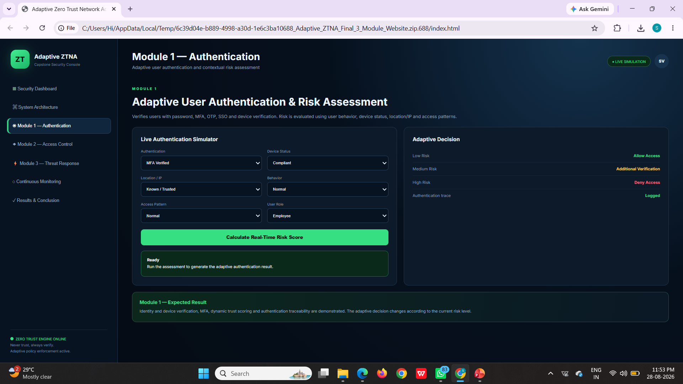
Result Of Module 1
CAPSTONE PROJECT

Slide 9
Module 2 – Zero Trust Access Control
& Continuous Monitoring
Zero Trust Access Control: Never trusts a user automatically, even after authentication.
Least-Privilege Access: Provides users access only to the applications and resources they are authorized to use.
Continuous Monitoring: Continuously monitors user behavior, device status, and network activity.
Real-Time Response: Detects suspicious changes and can re-authenticate, restrict, or deny access.
Main Purpose: Continuously protect resources by adapting access according to changing security risks.

Slide 10
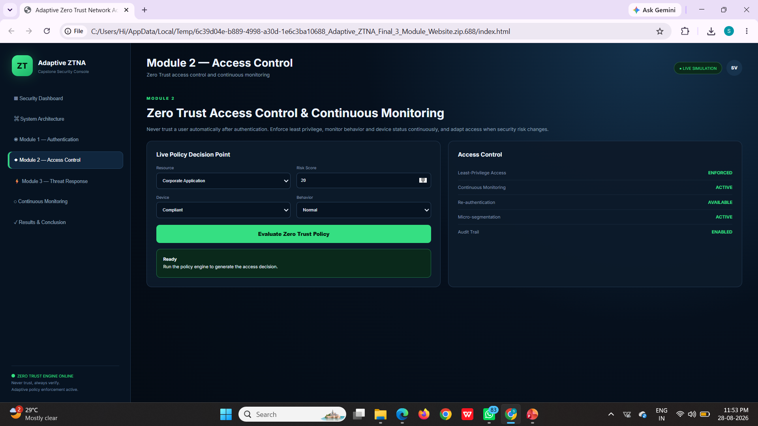
Result Of Module 2
CAPSTONE PROJECT

Slide 11
Module 3 – Adaptive Threat Response &
Security Policy Enforcement
Instant Threat Detection: Constantly watches live activity and spots suspicious behavior right away.
Real-Time Rule Enforcement: Automatically updates access rules for apps and data whenever the risk changes.
Step-by-Step Defense: Takes the right action depending on the risk level—asking for an OTP, lowering permissions, or terminating the session.
Device Isolation: Quickly locks out hacked devices and suspicious IP addresses to protect the rest of the company network.
Main Purpose: Stop cyber threats instantly on its own without waiting for a security person to fix it.

Slide 12
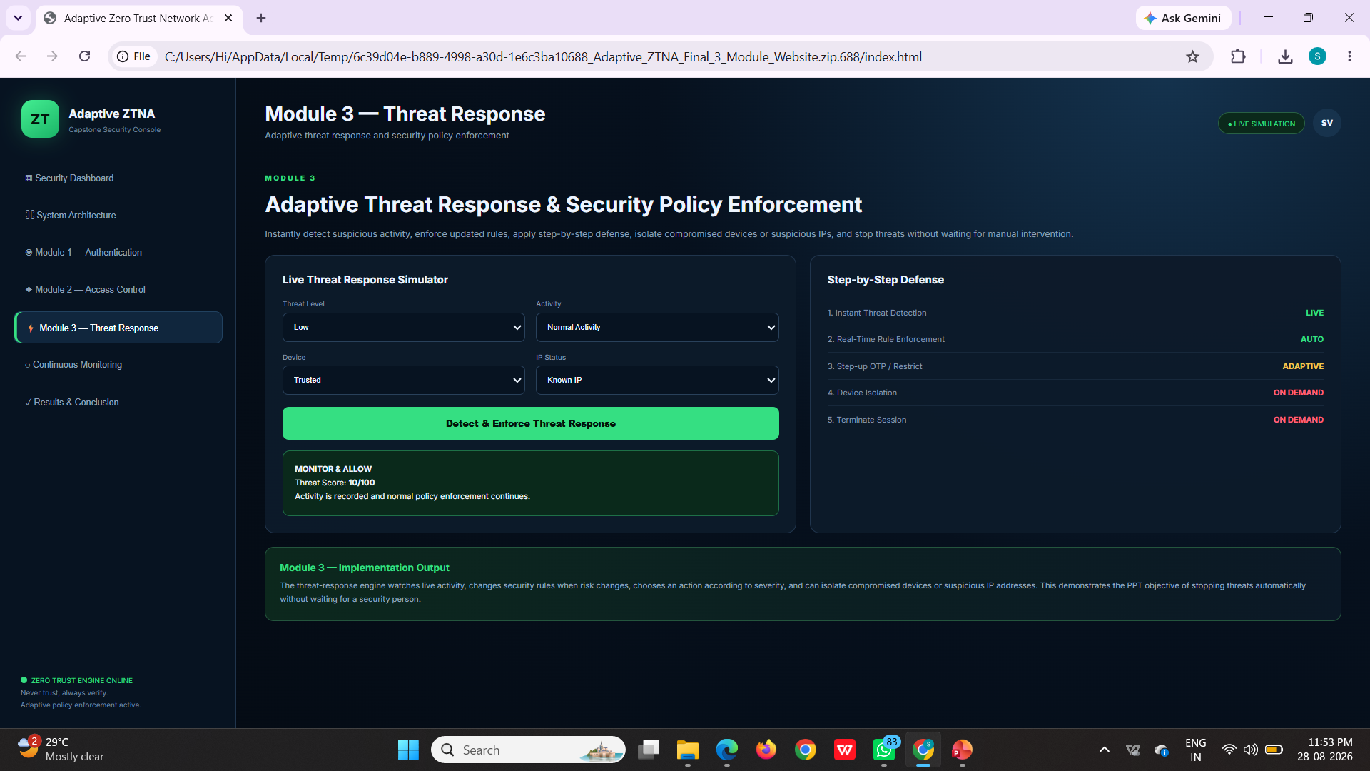
Result Of Module 3

Slide 13
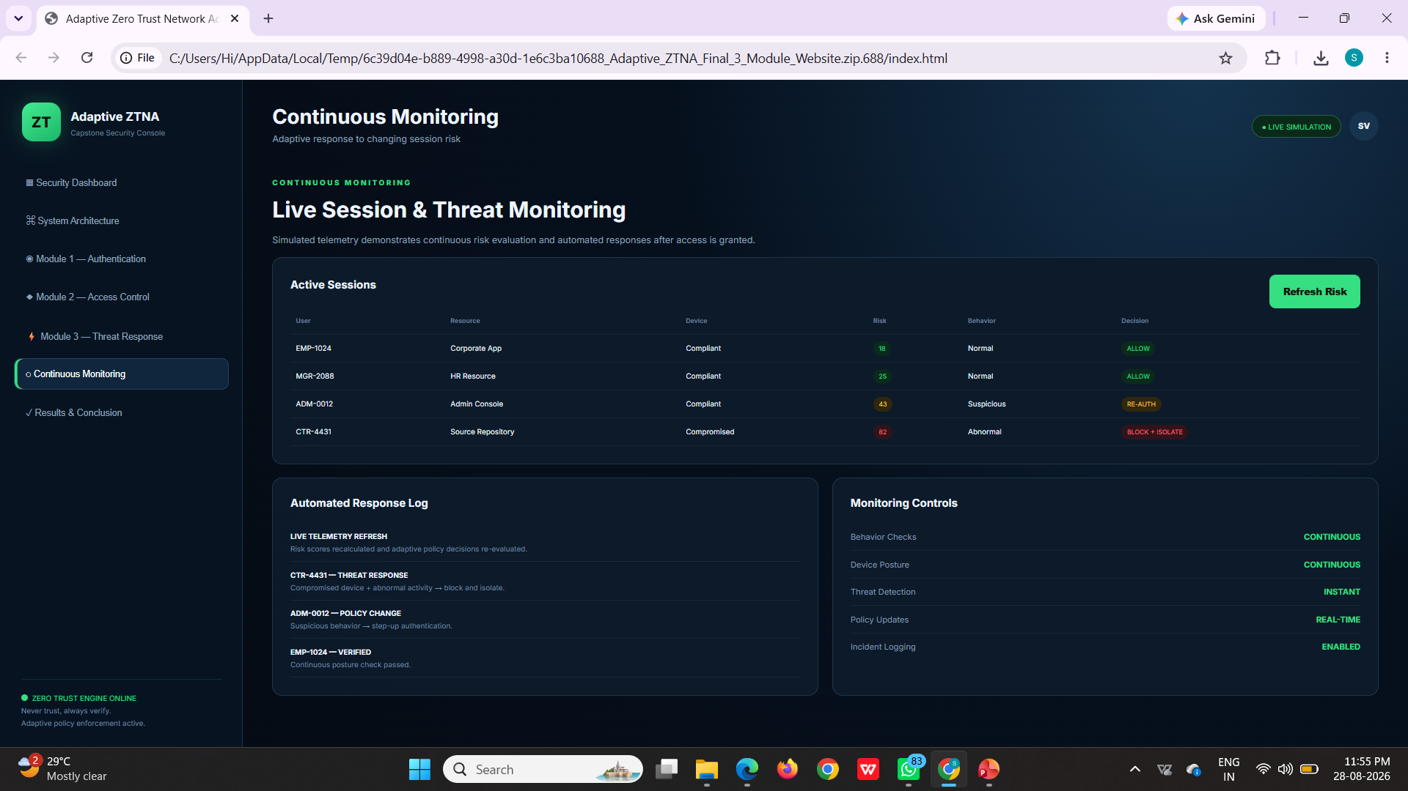
OVERALL RESULT

Slide 14
Conclusion
Developed an Adaptive Zero Trust Network Access Management System for modern distributed environments.
Replaced implicit perimeter trust with continuous identity, device, and context verification.
Implemented an adaptive policy engine that computes real-time, risk-based trust scores.
Enforced least-privilege, micro-segmented access with continuous session monitoring.
Established a scalable, future-ready security framework suited to cloud and hybrid enterprises.

Slide 15
Future Scope
Integration of AI/ML-driven behavioral analytics for smarter risk scoring
Extension to full multi-cloud and hybrid-cloud policy orchestration
Passwordless and biometric authentication for stronger identity assurance
Blockchain-based tamper-proof audit logging
Performance optimization for large-scale enterprise deployments
Native mobile and IoT device trust support
Real-time security dashboards and automated incident response

Slide 16
References
J. Kindervag, Build Security Into Your Network’s DNA: The Zero Trust Network Architecture, Forrester Research, 2010.
S. Rose, O. Borchert, S. Mitchell, and S. Connelly, Zero Trust Architecture, NIST Special Publication 800-207, NIST, 2020.
S. Kerman, O. Borchert, and S. Rose, Implementing a Zero Trust Architecture, NIST National Cybersecurity Center of Excellence, 2022.
C. Buck, C. Olenberger, A. Schweizer, F. Volter, and T. Eymann, Never Trust, Always Verify: A Review of Zero-Trust Research and Gaps, Computers & Security, 2021.
Cloud Security Alliance, Software Defined Perimeter and Zero Trust, CSA Publication, 2021.

Slide 17

THANK YOU

